Slide 1
Introduction
Drones have become increasingly popular in recent years, with a wide range of applications from aerial photography to delivery services. However, the rise of drones has also brought about new security concerns.
Unauthorized drone flights can pose a serious threat to public safety and national security. That's why it's important to have effective drone detection and tracking systems in place.

Slide 2
Problem Statement
The objective of this project is to develop a drone detection and tracking system using computer vision and deep learning techniques, specifically YOLOv8, Roboflow, and DeepSORT, to improve the accuracy, speed, and robustness of existing solutions. The system aims to detect and track drones in real-time, even under challenging conditions, such as occlusion, varying lighting, and complex backgrounds.

Slide 3
Objective
The goal of Drone Detection and Tracking using YOLOv8, Roboflow, and DeepSORT is to create a system that uses computer vision and deep learning techniques to identify and track drones in real time. By offering an effective and dependable solution for monitoring and managing drone movements, the system intends to address the rising concerns about unauthorised drone activity, such as privacy breaches and security risks. To allow real-time identification and tracking of drones, the project will use YOLOv8, a cutting-edge object recognition method, Roboflow, a platform for training and deploying computer vision models, and DeepSORT, a deep learning-based tracking system. The system will be intended to operate in a variety of contexts, including urban and rural locations, as well as in a variety of weather situations.

Slide 4
Dataset Description
The dataset consists of images captured from different viewpoints and distances, including aerial and ground-level perspectives, to simulate real-world scenarios.
The images in the dataset contain drone to provide a diverse range of objects and backgrounds for the models to learn from. The dataset also includes images captured under different conditions, such as bright cloudy, evening, and sunny, to ensure the models are robust to varying conditions.
The dataset is suitable for training and evaluating various computer vision models, including YOLOv8 and DeepSORT, for drone detection and tracking. It can also be used to benchmark different detection and tracking algorithms, and to evaluate the performance of existing solutions in different environments and conditions.

Slide 5
YOLOv8 Ultralytics
YOLOv8 ultralytics is a state-of-the-art object detection system that uses deep learning algorithms to detect and track objects in real-time. This technology is particularly useful for detecting drones, as it can identify them even when they are moving at high speeds or are partially obscured.
By using YOLOv8 ultralytics for drone detection, security personnel can quickly identify potential threats and take appropriate action to mitigate any risks.

Slide 6
Roboflow
Roboflow is an AI-powered computer vision platform that can be used to train machine learning models for object detection and tracking. By using Roboflow to train YOLOv8 ultralytics, we can improve the accuracy and effectiveness of our drone detection system.
Roboflow allows us to easily label and annotate images of drones, which can then be used to train the YOLOv8 ultralytics model. This results in a more robust and accurate drone detection system that can adapt to changing conditions and environments.

Slide 7
DeepSORT
DeepSORT is a tracking algorithm that can be used in conjunction with YOLOv8 ultralytics to track drones over time. This technology is particularly useful for monitoring drones that may be flying in complex patterns or changing directions frequently.
By using DeepSORT, we can accurately track the movement of drones and predict their future trajectory. This allows us to anticipate potential threats and take proactive measures to prevent any harm or damage.

Slide 8
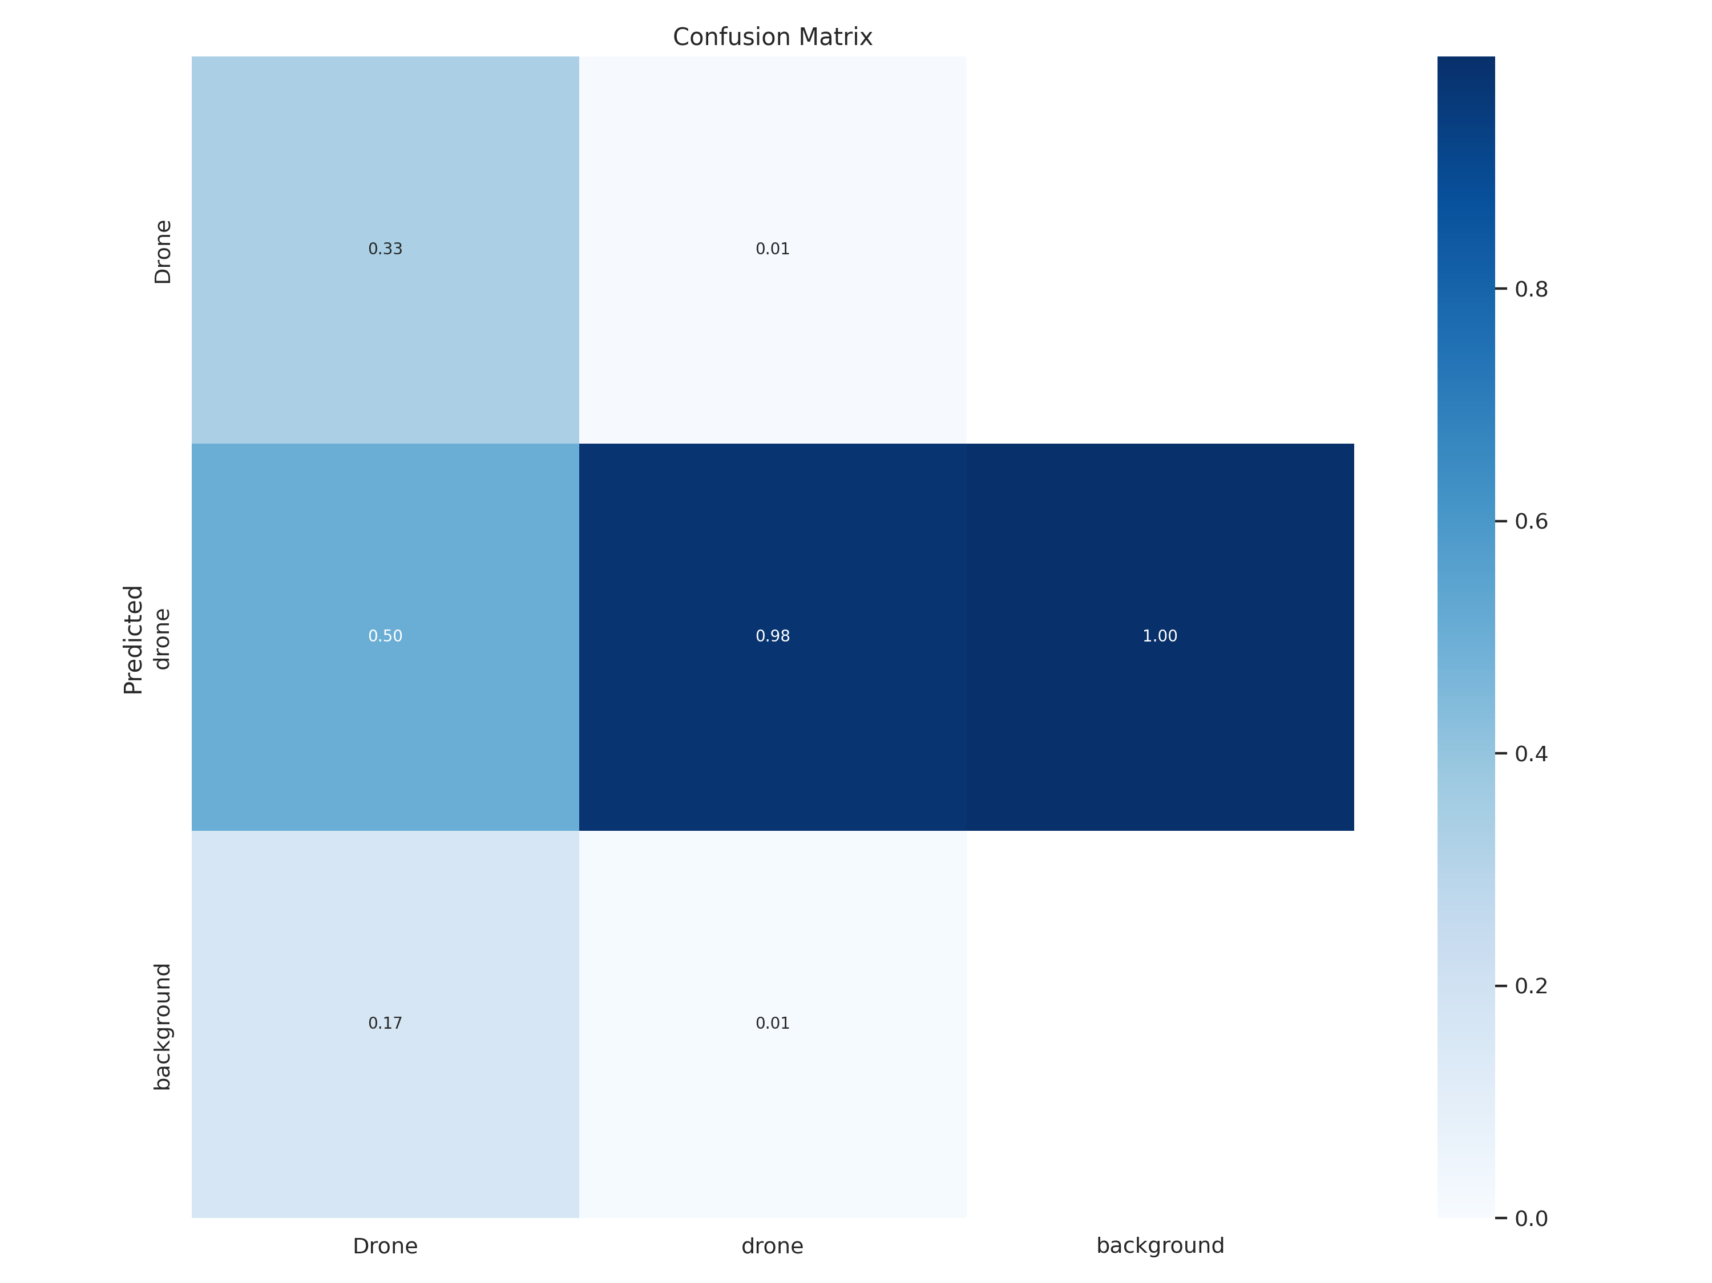
Results
Confusion Matrix

Slide 9
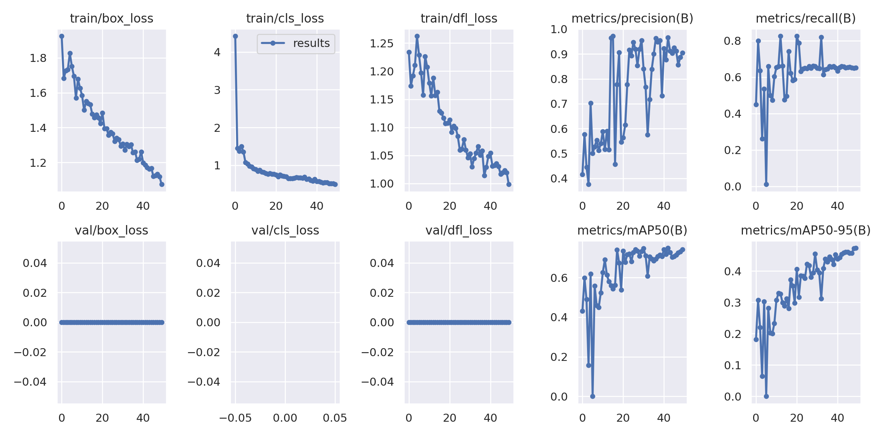
Results
Training and the Validation Loss

Slide 10
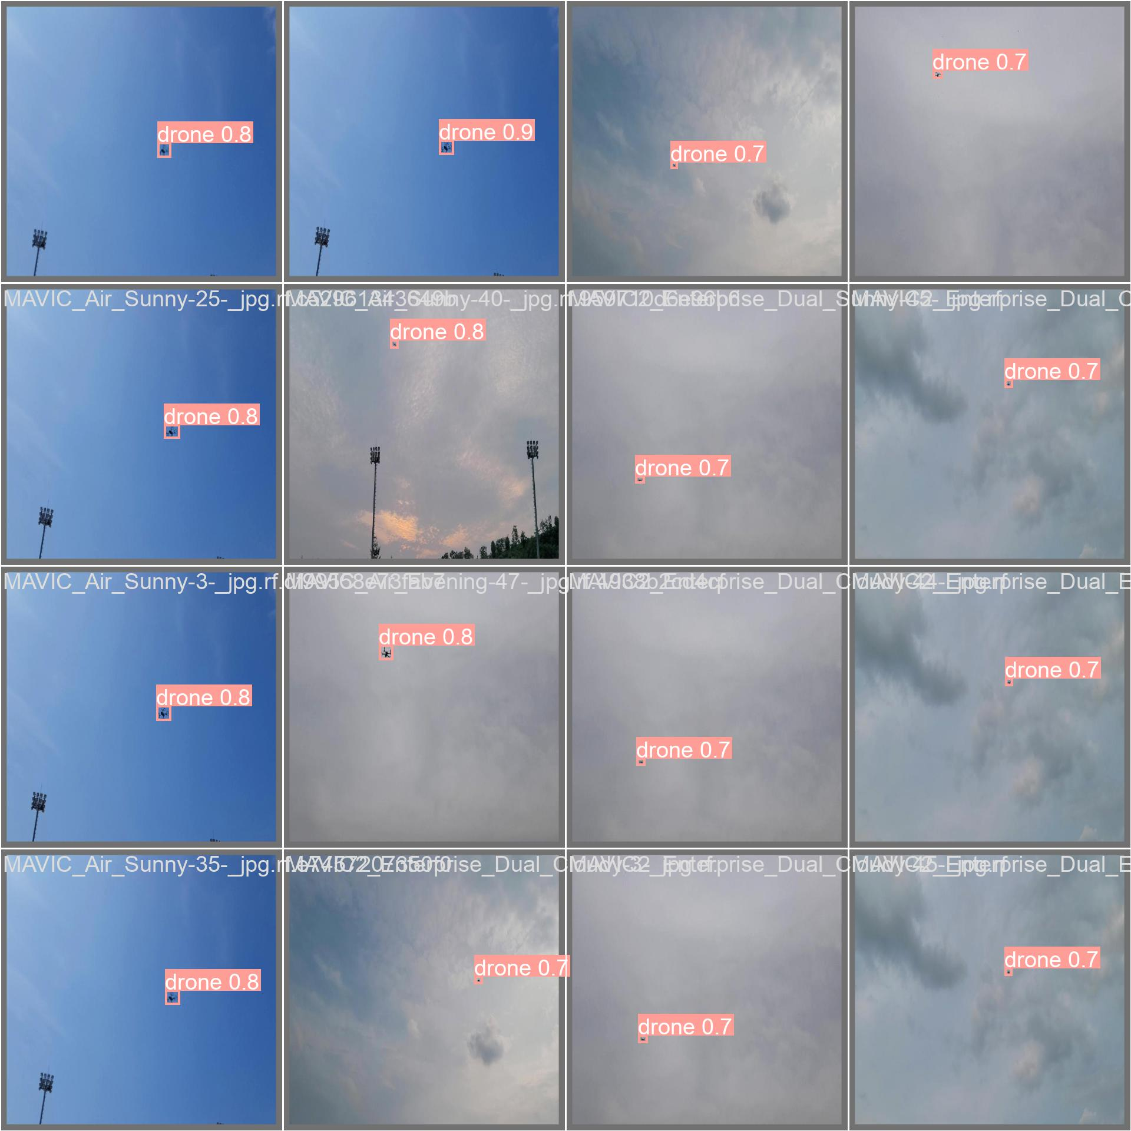
Results
Model Prediction on Validation Batch

Slide 11
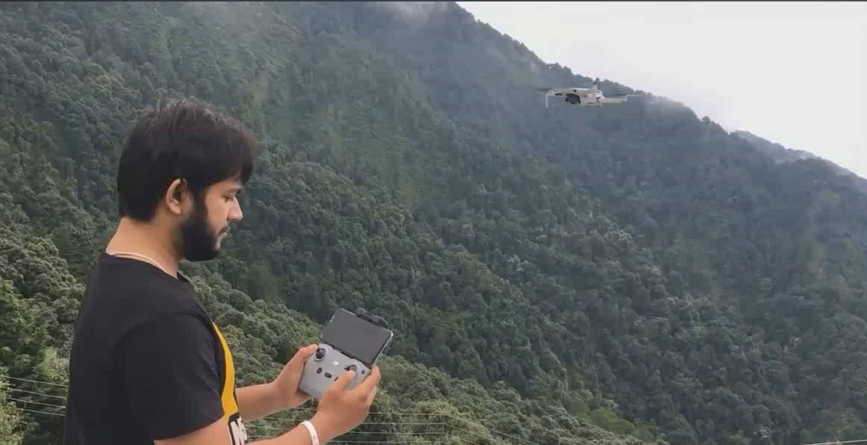

Slide 12
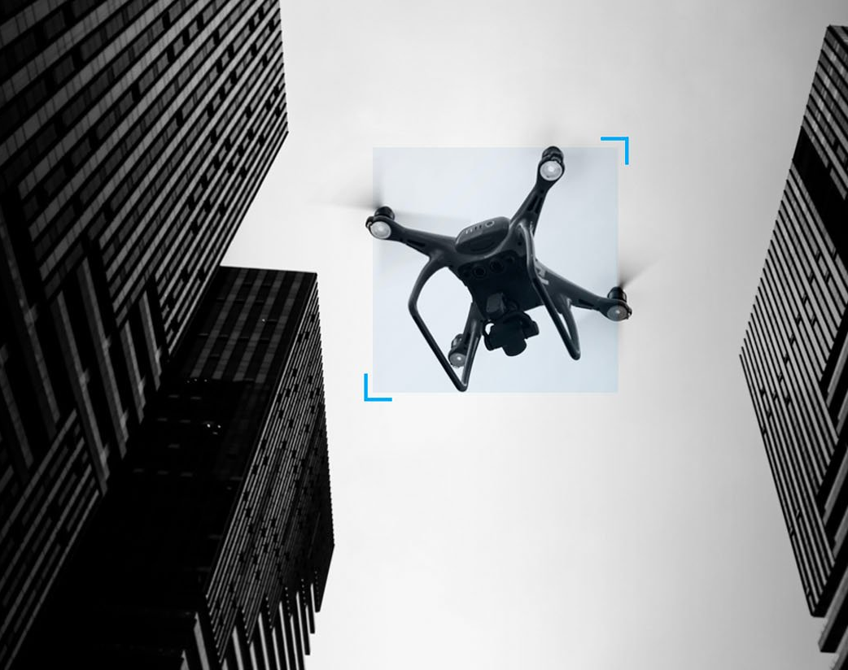
Conclusion
In conclusion, drone detection and tracking is an important area of research and development, with many potential applications in various fields. By using advanced technologies such as YOLOv8 ultralytics, Roboflow, and DeepSORT, we can develop powerful and effective systems for detecting and tracking drones, enhancing security and safety measures, and contributing to the betterment of society.
As drone technology continues to evolve, it is essential that we stay ahead of the curve and continue to innovate in this field. With the right tools and expertise, we can create a safer and more secure world for everyone.

Slide 13
Thank You!!

